Slide 1
Design and Analysis of Algorithms
Algorithms-II : CS345A
Website: hello.iitk.ac.in
Lecture 1
Divide and Conquer Paradigm - I

Slide 2
Divide and Conquer paradigm

Slide 3
An Overview
Divide the problem instance into two or more instances of the same problem.
Solve each smaller instance recursively (base case suitably defined).
Combine the solutions of the smaller instances
to get the solution of the original instance.
Notes:
How do we solve any problem in this paradigm ?
The 3rd step (Combine step) is usually the main nontrivial step in the design of an algorithm using divide and conquer strategy

Slide 4

Example Problems
Merge Sort
Multiplication of two $n$-bit integers.
Counting the number of inversions in an array.
Finding median of $n$numbers in linear time.

Slide 5
Divide and Conquer Paradigm (Advanced Problems)
Geometric Problems:
Closest Pair Distance
Convex Hull
Non-dominated Points
Number theoretic Problem
Multiplication of 2 Polynomials

Slide 6
problem 1
Closest Pair Distance

Slide 7





Distance between 2 points
$$(x_{j},y_{j})$$
O($1$) time
$$(x_{i},y_{i})$$
$$y$$
$$x$$

Slide 8

The Closest Pair Distance Problem
$$δ$$
$$y$$
$$x$$

Slide 9
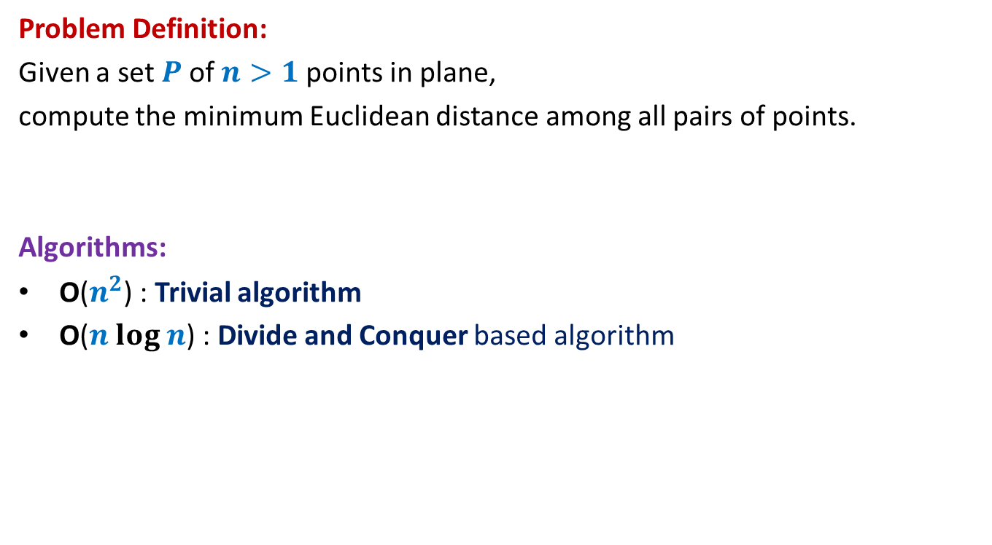
The Closest Pair Distance Problem
Problem Definition:
Given a set $P$of $n>1$points in plane,
compute the minimum Euclidean distance among all pairs of points.
Algorithms:
O($n^{2}$) : Trivial algorithm
O($n log n$) : Divide and Conquer based algorithm

Slide 10

Question 1
Tool 1
A fact from high school geometry
Fact :
Let $p=(x_{1},y_{1})$ and $q=(x_{2},y_{2})$ be any two points.
If $\left|x_{1}−x_{2}\right|>δ$, distance($p,q$) $>δ$
If $\left|y_{1}−y_{2}\right|>δ$, distance($p,q$) $>δ$

Slide 11
Question 2
Tool 2
A fundamental question about data structure ?
Question:
While solving an algorithmic problem, when do we feel the need of an
efficient data structure ?
Answer:
when the algorithm involves “many” operations of same type on a given data.
Notes:
For example, it is worth sorting an array only if there are going to be many search queries on it.
Let us see if you can use this principle to solve this problem.

Slide 12
a Divide and Conquer algorithm for
Closest Pair Distance

Slide 13



The divide step
O($n$) time
$$y$$
$$x$$
Right half set
Left half set
$⌈\frac{n}{2}⌉$points
$⌊\frac{n}{2}⌋$points

Slide 14



Solving the 2 smaller instances
$$δ_{L}$$
$$δ_{R}$$
$δ$ ← min($δ_{L}{,δ}_{R}$)
Notes:
1. Compute the closest pair distance of the left half set
2. Let it be Delta_L.
3.Compute the closest pair distance of the right half set
4. Let it be Delta_R.

Slide 15



The combine step
Tool 1
$$>δ$$
$$δ_{L}$$
$$δ_{R}$$
$$δ$$
$$δ$$
$δ$ ← min($δ_{L}{,δ}_{R}$)
Notes:
Which points do we need to focus on for the closest pairs ?
The total number of these pairs are Theta(n^2).
How to do it efficiently ?
Exploit the geometric aspect of the problem.
Time to use Hint 1.
For a point in the left half set, if its distance to any point in the right set is less than delta, can we infer anything about its x-coordinate.
: Its x-coordinate can not be less than the x-coordinate of the other point by more than delta.

Slide 16


The combine step
Potentially $Θ(n)$ points in each strip
$$δ_{L}$$
$$δ_{R}$$
$$δ$$
$$δ$$
$δ$ ← min($δ_{L}{,δ}_{R}$)
Notes:
But there may still be $Θ(n)$ points in each of these strips.
So what to do ?

Slide 17

The combine step
$$δ_{L}$$
$$p$$
$$δ_{R}$$
$$δ$$
$$δ$$
$δ$ ← min($δ_{L}{,δ}_{R}$)
Notes:
1. Focus on a point $p$in left strip.
2. Where do we have to search for the points in the right strip
that can be at distance < $δ_{L}$ from with $p$ ?

Slide 18

The combine step
$$δ_{L}$$
$$δ$$
$$p$$
$$δ$$
$$δ_{R}$$
$$δ$$
$$δ$$
$δ$ ← min($δ_{L}{,δ}_{R}$)

Slide 19
The combine step
Tool 1
$$δ_{L}$$
$$δ$$
$$p$$
$$δ$$
$$δ_{R}$$
$$δ$$
$$δ$$
$δ$ ← min($δ_{L}{,δ}_{R}$)
Notes:
1. Only the points lying in these 2 red squares are relevant as far as $p$ is concerned.
2. Time to use Hint 2
3. Surely not more than 8.
-----------------------------
1. How to find the points in these red square for point $p$?

Slide 20

A discrete math exercise
Tool 3
Exercise:
What is the maximum number of points that can be placed in a unit square
such that each pair of them is separated by distance at least 1 ?
Answer: 4.
$$\frac{1}{\sqrt{2}}$$
1
Notes:
If there are more than 4 points in the unit square,
at least one of the four small squares will have more than 1 points.

Slide 21


The combine step
$$δ_{L}$$
It will take $O(n)$time for a given $p$.
$O(1)$points only
$$δ$$
$$p$$
$$δ$$
$$δ_{R}$$
$$δ$$
$$δ$$
$δ$ ← min($δ_{L}{,δ}_{R}$)
Notes:
1. Only the points lying in these 2 red squares are relevant as far as $p$ is concerned.
2. Time to use Hint 2
3. Surely not more than 8.
-----------------------------
1. How to find the points in these red square for point $p$?

Slide 22
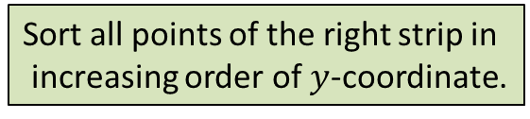






The combine step
Tool 2
$$δ$$
$$δ$$
$$δ$$
$$δ$$
Sort all points of the right strip in
increasing order of $y$-coordinate.
$$δ_{L}$$
$$δ$$
$$δ$$
$$δ$$
$$(x^{′},y^{′})$$
Binary search for ($y^{′}+δ$)
$$p$$
$$δ$$
Binary search for ($y^{′}−δ$)
$$δ_{R}$$
$$δ$$
$$δ$$
$δ$ ← min($δ_{L}{,δ}_{R}$)

Slide 23


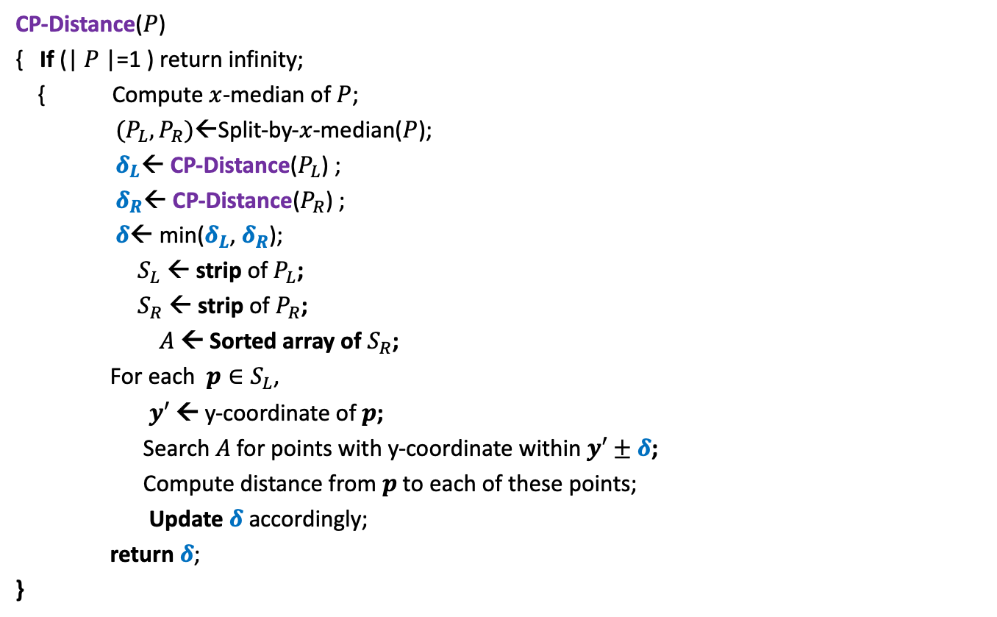
Divide and Conquer based algorithm
CP-Distance($P$)
{ If (| $P$|=1 ) return infinity;
{ Compute $x$-median of $P$;
$(P_{L},P_{R})$←Split-by-$x$-median($P$);
$δ_{L}$← CP-Distance($P_{L}$) ;
$δ_{R}$← CP-Distance($P_{R}$) ;
$δ$← min($δ_{L}$, $δ_{R}$);
$S_{L}$ ← strip of $P_{L}$;
$S_{R}$ ← strip of $P_{R}$;
$A$← Sorted array of $S_{R}$;
For each $p∈S_{L}$,
$y′$ ← y-coordinate of $p$;
Search $A$for points with y-coordinate within $y′±δ$;
Compute distance from $p$to each of these points;
Update $δ$ accordingly;
return $δ$;
}
$O(\left|P\right|)$ + 2 T(|$P$|/2) time
Divide step
$O(\left|P\right| \log{|P|})$ time
Combine/conquer step

Slide 24


Running time of the algorithm
What is the recurrence for running time?
T($n$) = c $n$ log $n$ + 2 T($n$/2)
➔
T($n$) = O( $n$ $\log^{2}n$)
Theorem:
There exists an O( $n$ $\log^{2}n$) time algorithm to compute the closest pair distance of $n$points in plane.
c $n$

Slide 25




The conquer step in O($n$) time
If the two strips are already sorted
$$δ_{L}$$
$$δ_{R}$$
$$δ$$
$$δ$$
$δ$ ← min($δ_{L}{,δ}_{R}$)

Slide 26





The conquer step in O($n$) time
If the two strips are already sorted
$$δ$$
$$p$$
$$δ_{L}$$
$δ$
$$q$$
$$δ_{R}$$
$$δ$$
$$δ$$
$δ$ ← min($δ_{L}{,δ}_{R}$)
Notes:
For each point in one strip, we need to find distance to points
in the upper red- square in the other strip.
2. How to do it efficiently using the fact that the strips are sorted ?

Slide 27


The conquer step in O($n$) time
Fact : At most 4 consecutive points need to be considered.
$$p$$
Homework: Prove this claim formally using Tool 3.

Slide 28
The conquer step in O($n$) time
If the two strips are already sorted
$$δ_{L}$$
$$δ_{R}$$
$$δ$$
$$δ$$
$δ$ ← min($δ_{L}{,δ}_{R}$)

Slide 29
The conquer step in O($n$) time
If the two strips are already sorted
$$δ_{L}$$
$$δ_{R}$$
$$δ$$
$$δ$$
$δ$ ← min($δ_{L}{,δ}_{R}$)

Slide 30
Inspiration from Merge sort
Merge
Notes:
In merge sort, the two recursive calls return sorted lists.
So creating the sorted list requires only merging them.

Slide 31


The conquer step in O($n$) time
$$δ_{L}$$
$$δ_{R}$$
$$δ_{L}$$
$$δ_{L}$$
Notes:
If $P_{L}$ and $P_{R}$ are sorted according to y-coordinate,
Getting the strips sorted according to y-coordinate
Getting $P$sorted by merging them
takes O($n$) time. ☺

Slide 32
Homework
Make sincere attempts to write a neat pseudocode of the algorithm.
One such pseudocode is given on the following slide.

Slide 33


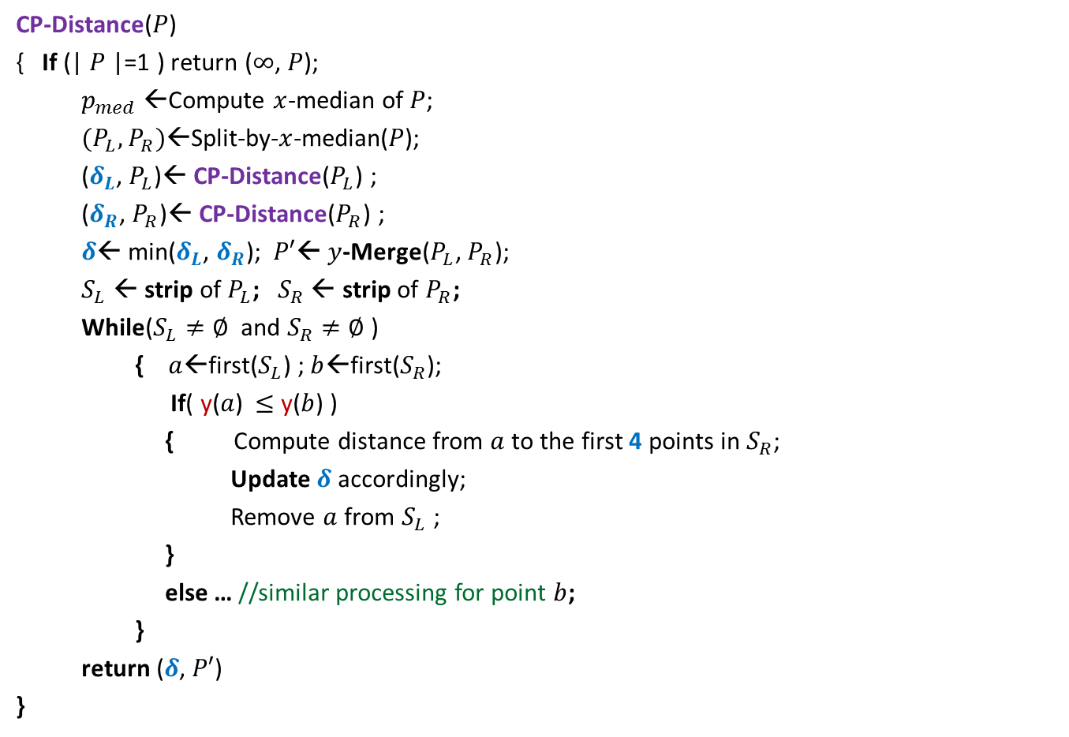
Divide and Conquer based algorithm
CP-Distance($P$)
{ If (| $P$|=1 ) return ($∞$, $P$);
$p_{med}$←Compute $x$-median of $P$;
$(P_{L},P_{R})$←Split-by-$x$-median($P$);
($δ_{L}$, $P_{L}$)← CP-Distance($P_{L}$) ;
($δ_{R}$, $P_{R}$)← CP-Distance($P_{R}$) ;
$δ$← min($δ_{L}$, $δ_{R}$); $P′$← $y$-Merge($P_{L}$, $P_{R}$);
$S_{L}$ ← strip of $P_{L}$; $S_{R}$ ← strip of $P_{R}$;
While($S_{L}≠∅$ and $S_{R}≠∅$ )
{ $a$←first($S_{L}$) ; $b$←first($S_{R}$);
If( y($a$) $≤$ y($b$) )
{ Compute distance from $a$to the first 4 points in $S_{R}$;
Update $δ$ accordingly;
Remove $a$ from $S_{L}$ ;
}
else … //similar processing for point $b$;
}
return ($δ$, $P′$)
}
$O(\left|P\right|)$ + 2 T(|$P$|/2) time
Divide step
$O(\left|P\right|)$ time
conquer step

Slide 34

Conclusion
Theorem:
There exists an O( $n$ $\log{n}$) time algorithm to compute the closest pair distance of $n$points in plane.
Note: There exists a randomized algorithm with O($n$) expected time.

Slide 35
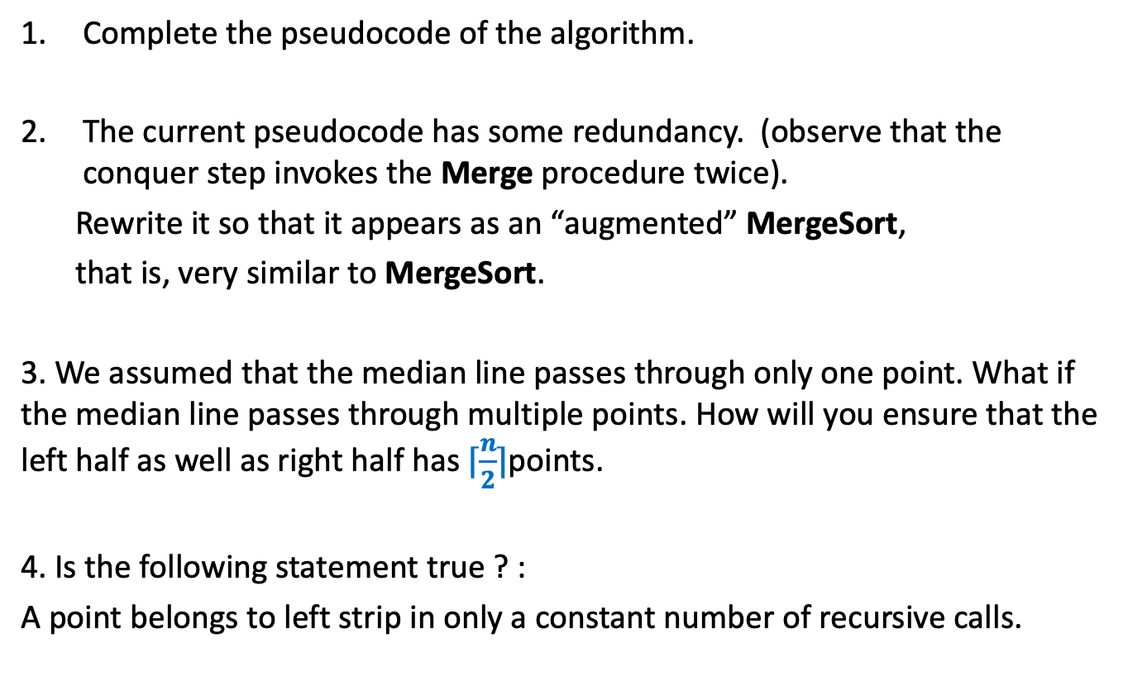
Homework
Complete the pseudocode of the algorithm.
The current pseudocode has some redundancy. (observe that the conquer step invokes the Merge procedure twice).
Rewrite it so that it appears as an “augmented” MergeSort,
that is, very similar to MergeSort.
3. We assumed that the median line passes through only one point. What if the median line passes through multiple points. How will you ensure that the left half as well as right half has $⌈\frac{n}{2}⌉$points.
4. Is the following statement true ? :
A point belongs to left strip in only a constant number of recursive calls.

